Slide 1



ENT 205
Introduction to
Innovation and Entrepreneurship
Course Introduction
Part A: Course Structure and Grading
Dr. Tim Faley
Kiril Sokoloff Distinguished Professor of Entrepreneurship
Special Assistant to the President for Entrepreneurial Initiatives
University of the Virgin Islands
Tfaley@UVI.edu

Slide 2
Course Materials
Textbook:
  The Entrepreneurial Arch: A Strategic Framework for Discovering, Developing and Renewing Firms,
    Published by Cambridge University Press, 2015
    Author: Timothy L. Faley (me)
    Available at Amazon.com: Kindle version, paperback, or hardcover
    www.amazon.com/author/timfaley
Additional Reading Material
  Supplemental material will be posted on Blackboard
    Under “Contents” tab in “Readings” folder (see next slide)
      Readings
      Articles, Book chapters, Blogs, Cases

Slide 3
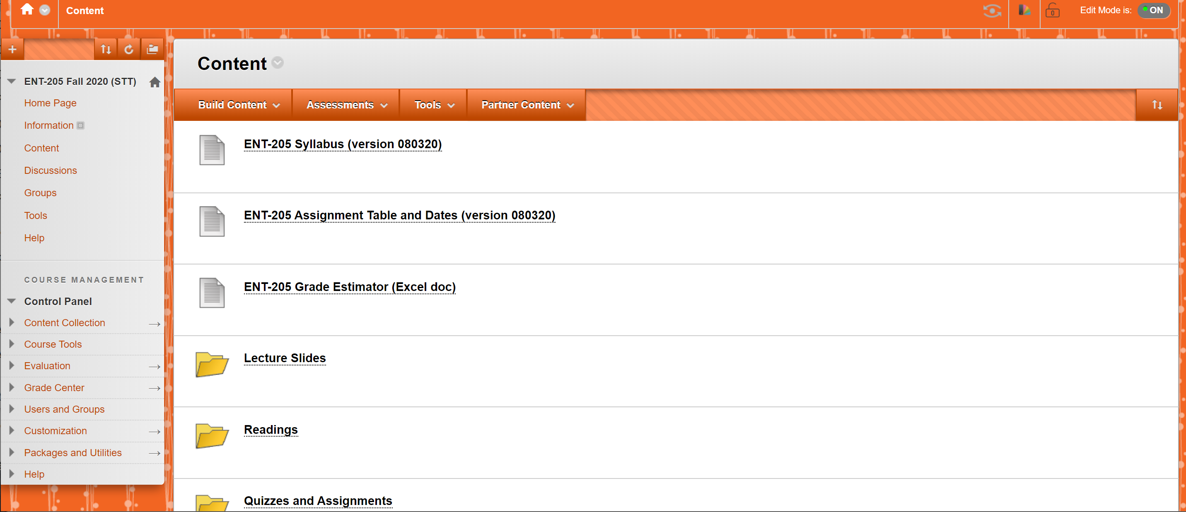


Slide 4
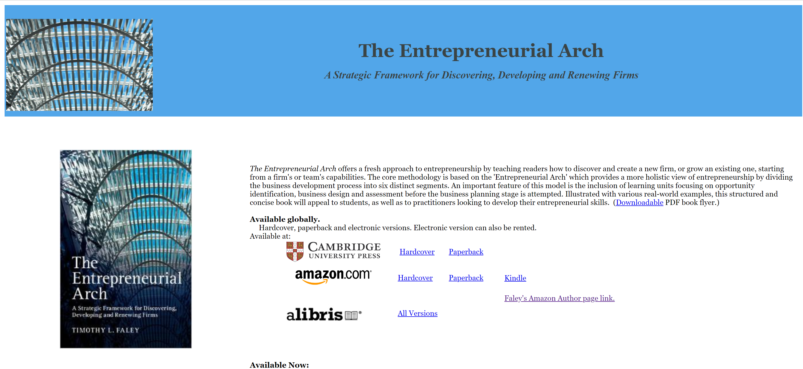
EntrepreneurialArch.com Website
https://www.entrepreneurialarch.com/

Slide 5
Course Format
Lectures and discussions
  Lectures re-inforce content from readings
    Two sets of lecture slides will be available
      The ones on the Blackboard site will have NO Voiceover
        This is a small file that you can flip through quickly
      The ones on https://www.entrepreneurialarch.com/ will be with Voice-over (so you can hear me talk through the slide)
        Will likely need to download these slides, then open them
          They are not on the Blackboard site as the University is requiring all instructors to limit the size of their courses on Blackboard and these voice-over slide decks are quite large
        Document posted in “Lecture Slide” folder that instructs you on how to listen to “voice-over” slides
      You MUST download and listen to the voice-over slides or you will miss critical content of the course (and not do well on your quizzes and exams!)

Slide 6
Voice-over Lecture Slide Location
Scroll down towards the bottom of the page on https://www.entrepreneurialarch.com/
Section Called “ENT 205 Students”
  List of voice-over lecture slides
  Click on any of the links provided to download the slide deck
    See graphic on the next slide
  Once it is downloaded, open it and listen to them by initiating “slideshow” in PowerPoint
    See document “How to listen to Voice-over PowerPoint Deck Slides”

Slide 7
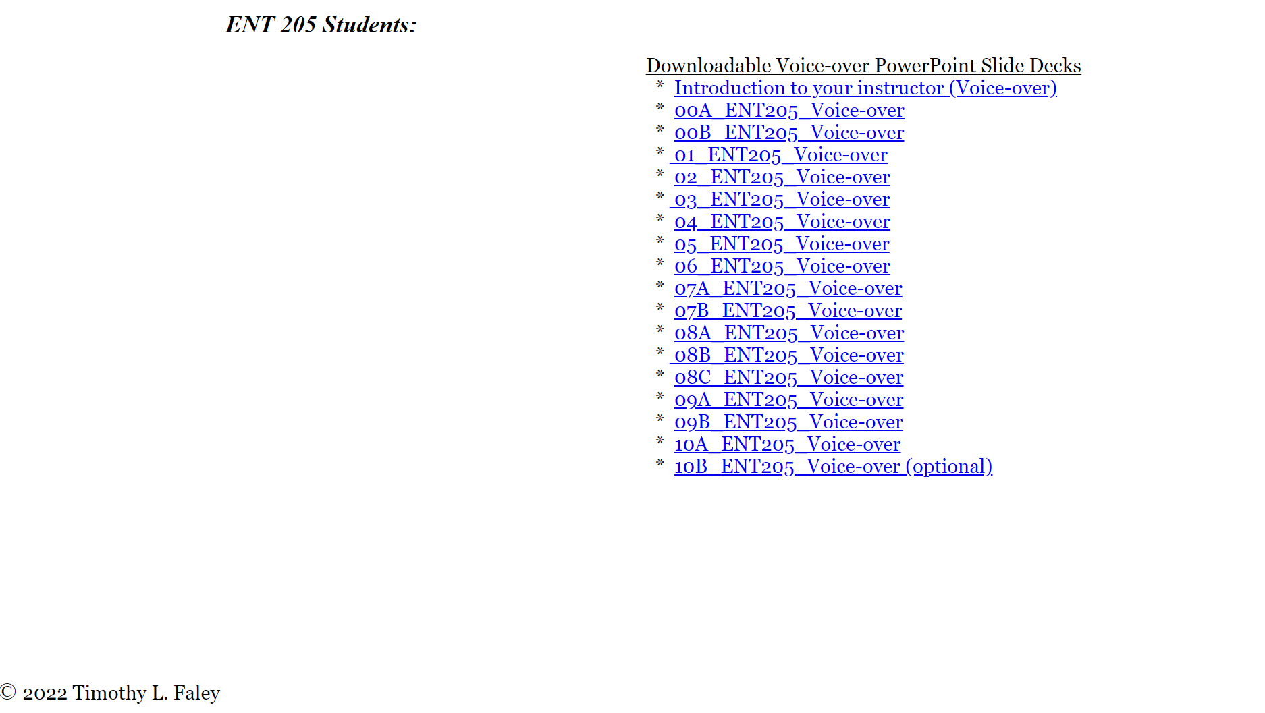
Lecture Slides (Voice-over)
https://www.entrepreneurialarch.com/
  Scroll down until you see, then click on any lecture slide deck to download it

Slide 8
Course evaluation
Quizzes & Assignments (35% of your grade)
    Six Graded Quizzes (T/F, Multiple-choice questions)
    Based on readings
    Can take TWICE before “drop dead date” (highest grade will count)
    Syllabus contains a “goal” time to take the quizzes
      This will keep you from falling behind (This is the “due date”)
    If you fail complete the quiz by the “final deadline,” (“drop dead date”) then you will receive a ZERO for the quiz (Note dates on syllabus and Assignment Schedule)
  Two written assignments
    Test your ability to apply the course material
    No “do-overs” – feedback is part of learning process (use the provided feedback to improve future work)
  Lowest quiz/assignment grade of the 8 will be dropped
Midterm and Final (30% and 35% respectively)
  Midterm – written: case write-up or an experiential project
  Final – Combination of quiz-like questions and short-answer questions

Slide 9
Grading Summary
    Total Course is 2000 points
    Best 7 scores of the 8 Quizzes and Assignments: 700 points possible
    Midterm: 6x your midterm score: 600 points possible
    Final exam: 7x your final exam score: 700 points possible
    TOTAL 2000 points possible
    2000 to 1800 points (A to A-)
    1799 to 1600 points (B+ to B-)
    1599 to 1400 points (C+ to C-)
    1399 to 1200 (D)
    Below 1200 (F)
    MAKE SURE NOT to count all 8 Quizzes and assignments (Blackboard does, you have to manually subtract out the lowest)

Slide 10
Syllabus is important!
Plan is to follow the syllabus VERY closely
Check the syllabus for due dates (and especially “drop dead” dates of quizzes
Check syllabus for lecture slide timing
  Slides will be posted way ahead of time
  Try to stay up, falling behind can be dangerous to your grade!
Any date changes (from the syllabus) will be made on BlackBoard Announcements

Slide 11
Office Hours
Office Hours
  And by appointment: In–person or via phone or skype or zoom. ALWAYS e-mail (Tfaley@UVI.edu) to set up an appointment
    Include ENT 205 in the subject line of the e-mail
Office: Wont’t be there due to pandemic
Phone: Rarely check voice-mail
tfaley@uvi.edu
  I check e-mail frequently!
Try this FIRST

Slide 12

Next Slide Deck…
00B_ENT205_Course Intro
Will introduce course content
Questions?
  E-mail them to me. If it is a general question I’ll provide the answer to the entire course via a Blackboard “announcement”

